Slide 1
Ticket Management System
Code Review
Isaac Adducchio | Elle Russo | Brendan Fisher | Colton Zeinner

Slide 2
Coding Standards
Commenting/Formatting
Since we are all new to PHP commenting was very important
Use proper indentation and add white space for readability
SQL Queries
Name $sql = and capitalize query
Or die
Use or die exit function whenever writing to the database to easily find errors
Naming Conventions
Table Names all CAPS
Table Columns First Letter Capital
Variables lowercase
Use filenames that clearly describe script function
ticketcreate.php, ticketsave.php ticketassign.php etc.

Slide 3
ticketsave.php
Pull user inputs from create ticket webpage
Check validity of inputs
Assign ticket to an administrator with least tickets
Write all information to database
Output ticket ID for user tracking
Redirect to login page

Slide 4
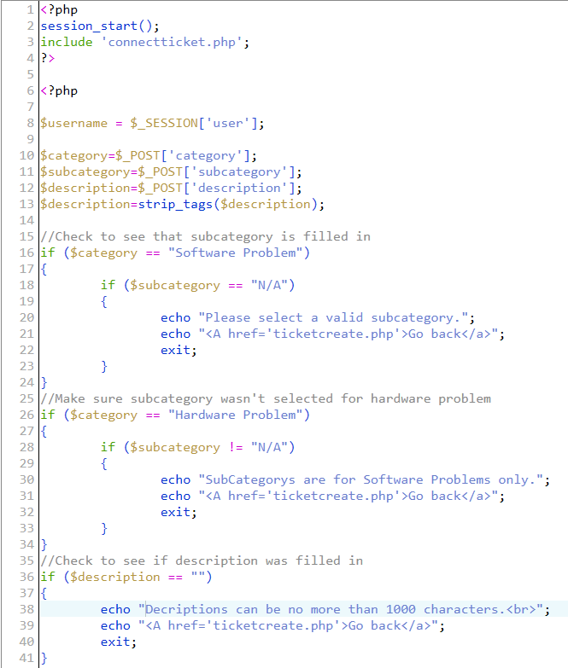
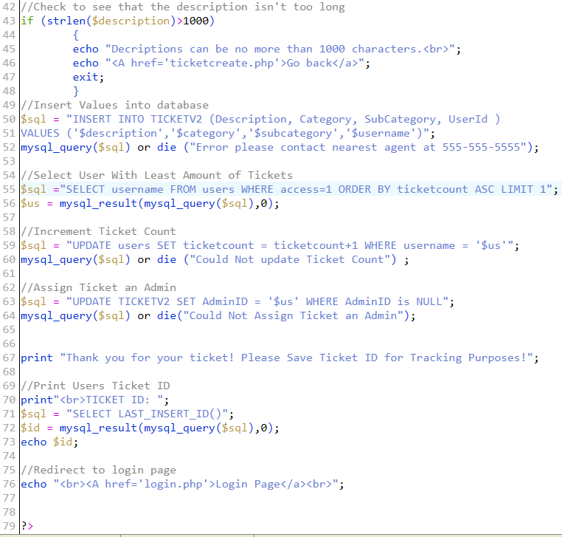
Notes:
Lines 15-48: Validate the user’s input. If the user enters invalid text into a field, he is prompted to make corrections.
Lines 49-52: Put the ticket into the database
Lines 54-60: Assign the ticket to the administrator who has the least tickets.
Naming Deviations - users table named in lowercase and it was too late to change
Print ticket ID relies on querying last value insert instead of primary key
Redirects when invalid information is entered rather than displaying error on same page
Echo errors is better than or die because of crazy errors to user.

Slide 5
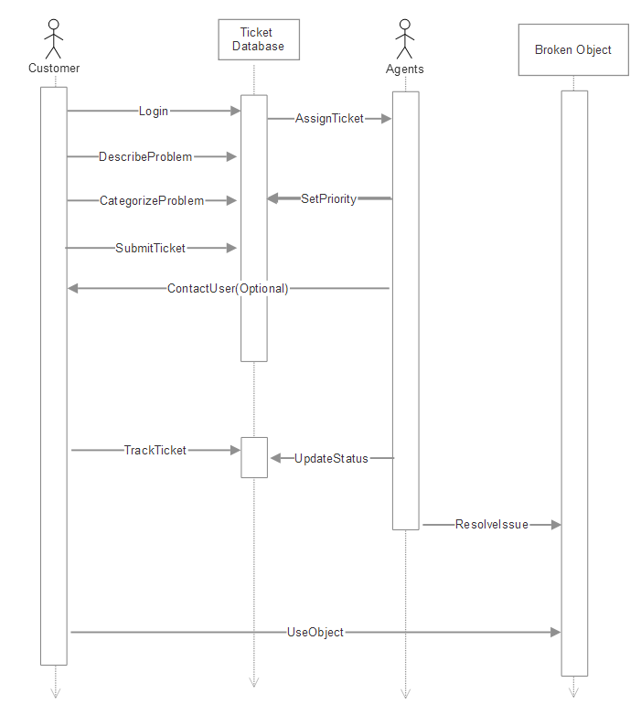
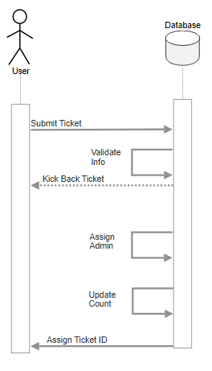
Original Sequence Diagram
Ticketsave.php Sequence Diagram

